Slide 1
Azoulay, Pierre, Christian Fons-Rosen, and Joshua S. Graff Zivin. 2019. "Does Science Advance One Funeral at a Time?" American Economic Review, 109 (8): 2889-2920.
小组成员分工
龚曼宁：Table1 2 Figure1 2
佟彤：Figure 3
李锦坡：Table3-7

Slide 2
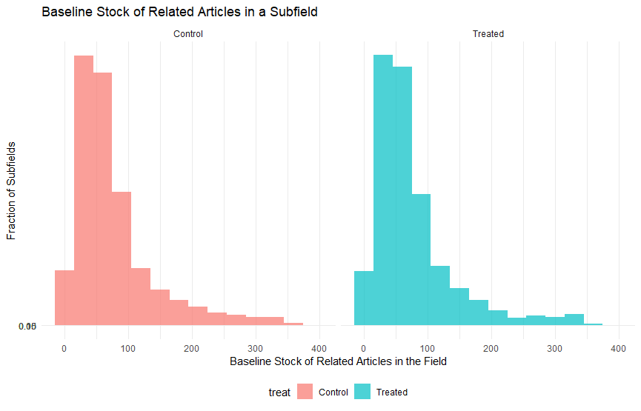
Figure 1. Cumulative Stock of Publications at Time of Death

Slide 3
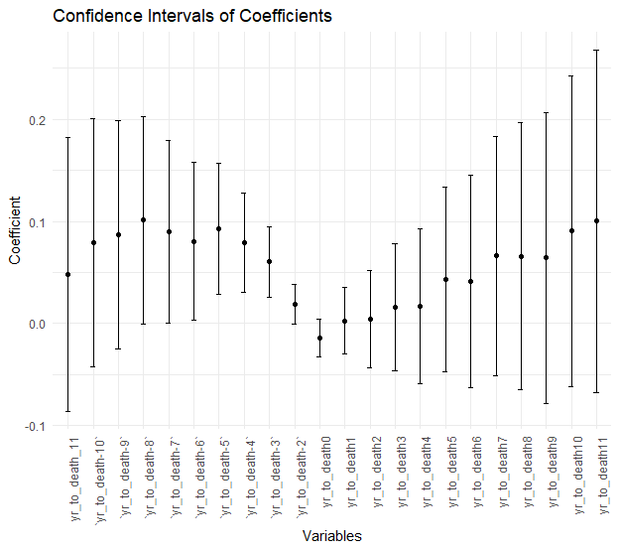
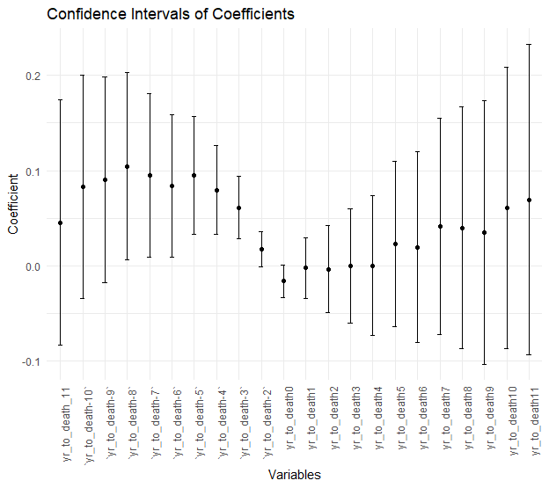
Figure 2. Effect of Star Scientist Death on Subfield Growth and Decline

Slide 4
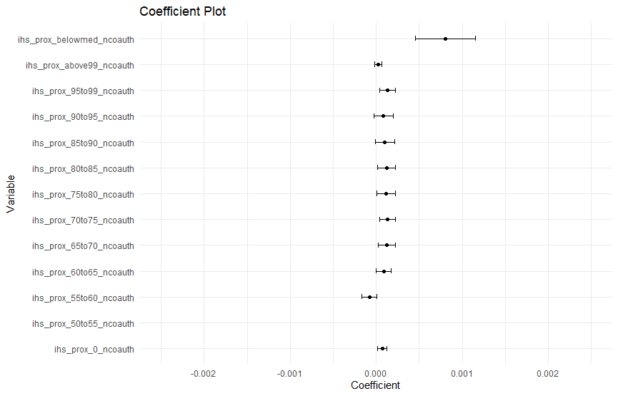
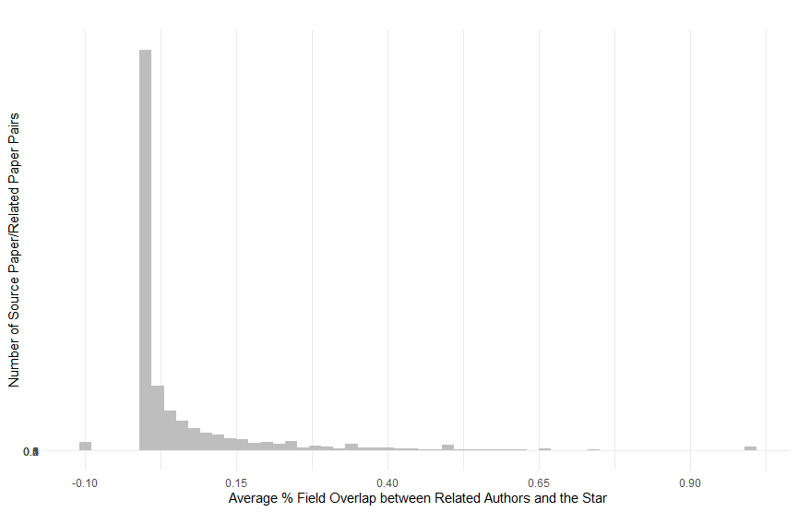
Figure 3. Characteristics of Related Authors: Competitors or Outsiders?

Slide 5
Table 1—Summary Statistics: Deceased Superstar Scientists
VARIABLE | mean | median | sd | min | max
Year of Birth | 1,932.97 | 1,934.00 | 10.57 | 1,899.00 | 1,959.00
Degree year | 1,960.08 | 1,961.00 | 10.90 | 1,928.00 | 1,986.00
Year of Death | 1,991.05 | 1,991.00 | 7.99 | 1,975.00 | 2,003.00
Age at Death | 58.08 | 58.00 | 8.79 | 34.00 | 91.00
Female | 0.10 | - | 0.30 | - | 1.00
MD Degree | 0.36 | - | 0.48 | - | 1.00
PhD Degree | 0.50 | 1.00 | 0.50 | - | 1.00
MD/PhD Degree | 0.14 | - | 0.35 | - | 1.00
Sudden Death | 0.44 | - | 0.50 | - | 1.00
Nb. of Subfields | 14.64 | 12.00 | 11.48 | 1.00 | 57.00
Career Nb. of Pubs. | 169.30 | 143.00 | 118.22 | 12.00 | 1,380.00
Career Nb. of Citations | 11,518.00 | 8,726.00 | 10,148.48 | 120.00 | 72,122.00
Career NIH Funding | 17,633,187.58 | 12,049,690.00 | 24,951,942.10 | - | 329,968,960.00
Sits on NIH Study Section | 0.01 | - | 0.08 | - | 1.00
Career Nb. of Editorials | 0.10 | - | 0.89 | - | 17.00

Slide 6
Table 2—Summary Statistics: Control and Treated Subfields at Baseline
TREAT=1 | mean | median | sd | min | max
Baseline Stock of Related Articles in the Field | 76.28 | 58.00 | 64.05 | - | 368.00
Baseline Stock of Related Articles in the Field, Non-Collaborators | 67.75 | 50.50 | 59.73 | - | 357.00
Baseline Stock of Related Articles in the Field, Collaborators | 8.53 | 5.00 | 9.84 | - | 86.00
Investigator Gender | 3.99 | 4.00 | 1.91 | 1.00 | 14.00
Death Year | 16.69 | 8.00 | 36.33 | - | 920.00
Age at Death | 70.43 | 35.00 | 180.53 | 1.00 | 6,598.00
Investigator Cuml. Nb. of Publications | 0.10 | - | 0.30 | - | 1.00
Investigator Cuml. Nb. of Citations | 1,960.14 | 1,961.00 | 10.90 | 1,928.00 | 1,986.00
Source Article Nb. of Authors | 1,991.12 | 1,991.00 | 7.97 | 1,975.00 | 2,003.00
Source Article Long-run Citations | 58.10 | 58.00 | 8.80 | 34.00 | 91.00
Source Article Citations at Baseline | 169.50 | 143.00 | 118.11 | 12.00 | 1,380.00
Investigator Cuml. NIH Funding at Baseline | 17,637,725.57 | 12,049,690.00 | 24,873,017.73 | - | 329,968,960.00
Investigator Year of Degree | 11,579.98 | 8,726.00 | 10,212.01 | 120.00 | 72,122.00
TREAT=0 | mean | median | sd | min | max
Baseline Stock of Related Articles in the Field | 76.28 | 58.00 | 64.05 | - | 368.00
Baseline Stock of Related Articles in the Field, Non-Collaborators | 67.75 | 50.50 | 59.73 | - | 357.00
Baseline Stock of Related Articles in the Field, Collaborators | 8.53 | 5.00 | 9.84 | - | 86.00
Investigator Gender | 3.99 | 4.00 | 1.91 | 1.00 | 14.00
Death Year | 16.69 | 8.00 | 36.33 | - | 920.00
Age at Death | 70.43 | 35.00 | 180.53 | 1.00 | 6,598.00
Investigator Cuml. Nb. of Publications | 0.10 | - | 0.30 | - | 1.00
Investigator Cuml. Nb. of Citations | 1,960.14 | 1,961.00 | 10.90 | 1,928.00 | 1,986.00
Source Article Nb. of Authors | 1,991.12 | 1,991.00 | 7.97 | 1,975.00 | 2,003.00
Source Article Long-run Citations | 58.10 | 58.00 | 8.80 | 34.00 | 91.00
Source Article Citations at Baseline | 169.50 | 143.00 | 118.11 | 12.00 | 1,380.00
Investigator Cuml. NIH Funding at Baseline | 17,637,725.57 | 12,049,690.00 | 24,873,017.73 | - | 329,968,960.00
Investigator Year of Degree | 11,579.98 | 8,726.00 | 10,212.01 | 120.00 | 72,122.00

Slide 7
Table 3—7
Result show in R code.

